Slide 1


Front end
(Html)
Lecture-5

Slide 2
Today’s Agenda
Creating Tables In Html
Attributes Of Table
Generating Irregular Tables

Slide 3
Tables In HTML
Tables are very useful to arrange in HTML and they are used very frequently by almost all web developers.
Tables are just like spreadsheets and they are made up of rows and columns.
The table element is used to create tables , with appropriate headers to identify the data contained in each column and row.

Slide 4
Creating Tables
At its most basic, a table is built using 4 tags:
<table>
Used as Container tag
<tr>
Used to generate row
<td>
Used to generate column
<th>
Used to generate column heading

Slide 5
General Syntax
<table >
<tr>
<td> some data</td>
<td>some data</td>
</tr>
<tr>
<td>some data</td>
<td>some data</td>
</tr>
</table>

Slide 6
Creating Header Cells
Two types of cells can be defined in an HTML table. One of them is the simple cell , created using <td> tag.
The other one is a special type of cell created using <th> element, that contains header information for a set of specified cells.
Browsers render the content of header cells in a special way ,as centered bold text

Slide 7
Various Attribute Of <table> Tag
The <table> tag has following important attributes:
border
Sets the border width in numerical values from 0 and up.
cellspacing
Empty space between table data cells.
cellpadding
Empty space between the edge of a cell and cell content.

Slide 8
Various Attribute Of <table> Tag
align
Aligns the table to the left, right or center.
width/height
The width/height of the table; measured in pixels or percentage.
bgcolor
Background color for all cells that do not have a background color or image specified.

Slide 9
Various Attribute Of <table> Tag
background
Background image for all cells that do not have a background color or image specified.
bordercolor
Border color for the table.

Slide 10
Attributes Of <tr> Tag
These attributes help us further customize our table and will override the ones set in the table tag.
<tr> tag supports following attributes :
1.bgcolor
This attribute is like the one set in the table only it will define the background color for the row only and not the entire table.
<tr bgcolor=“#00FF00">

Slide 11
Attributes Of <tr> Tag
2. align
The align attribute for the table row is different from the table align attribute, this aligns the content in the row with respect to the table. The values are: left, right and center. The default. Left
<tr align=“right">
3. valign
This is the vertical alignment attribute. It defines the vertical alignment of the content within the row. The values for this attribute are: top, middle, bottom. The default setting is middle.
<tr valign=“bottom">

Slide 12
Attributes Of <td> Tag
This is where we can customize each cell separately. Any attributes defined for a cell will override the attributes defined in that row.
<td> tag supports following attributes :
bgcolor Just like the bgcolor attribute in the tr tag, this attribute works the same. It will define a background color for each cell. <td bgcolor="#0000FF">

Slide 13
Attributes Of <td> Tag
2. align
This attribute also works the same as in the tr tag, it will align the content in within each cell. The values are: left, right, and center. The default is Left .
<td align="center">

Slide 14
Attributes Of <td> Tag
3. valign
This attribute also works the same as in the tr tag, it vertically aligns the content within the cell. The values are: top, middle, bottom. The default is middle.
<td valign=“top”>

Slide 15
Using “colspan” And “rowspan” Attributes
Table cells can span across more than one column or row.
The attributes colspan ("how many across") and rowspan ("how many down") indicate how many columns or rows a cell should take up.

Slide 16
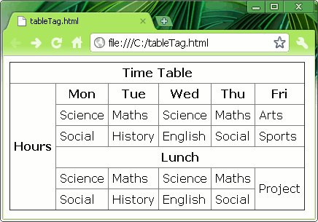
Sample Table

Slide 17
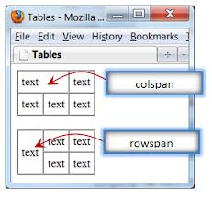
“colspan” And “rowspan”

Slide 18
“colspan” Syntax
<table >
<tr>
<td> some data</td>
<td>some data</td>
</tr>
<tr>
<td colspan=“2”>some data</td>
</tr>
</table>

Slide 19
“rowspan” Syntax
<table >
<tr>
<td rowspan=“2”> some data</td>
<td>some data</td>
</tr>
<tr>
<td >some data</td>
</tr>
</table>

Slide 20
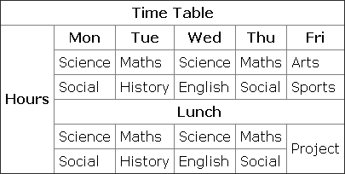
EXERCISE

Slide 21

End Of Lecture
For any queries mail us @: scalive4u@gmail.com
Call us @ : 0755-4271659, 9826686245
Agenda for Next Lecture:
Using HTML forms
Working with various form controls

